Slide 1



From Passwords to
Passkeys (and beyond…)
The Evolution of Authentication
Apple User Group | 2026

Slide 2



Why Should You Care?
80%
69%
4x
of breaches involve
stolen credentials
of people now have
at least one passkey
more successful sign-ins
with passkeys vs passwords
Source: FIDO Alliance 2025 / Verizon DBIR

Slide 3
Passwords Are Ancient
~1200 BC
"Shibboleth" — the Gileadites used a word
as a test to identify enemies at the river Jordan
Biblical Era
~100 AD
Watchwords passed among night guards
to distinguish allies from foes in the dark
Roman Military
1920s
Speakeasies required secret passwords,
knocks, or membership cards for entry
Prohibition
The idea of proving identity with a shared secret is thousands of years old.

Slide 4

1960s: The Digital Password Is Born
MIT, 1961
First Breach: 1962
Fernando Corbató invented the computer password for MIT's Compatible Time-Sharing System (CTSS). Multiple users shared one massive computer — passwords let each person keep their files private.
Passwords were stored in a plain text file. Anyone who found the file could read them all.
PhD student Allan Scherr printed out the entire password file to get more computing time for his research.
The lesson? Passwords were insecure from Day One. The very first password system was breached within a year of its creation.

Slide 5




1970s-2000s: Making Passwords Harder to Crack
1974
Hashing
Robert Morris develops one-way encryption — passwords stored as scrambled numbers, not plain text
1979
Salting
Random characters added before hashing, making identical passwords produce different stored values
1995
2FA Patented
AT&T patents two-factor authentication — proving who you are with something you know AND something you have
2000s
Complexity Rules
"Must include uppercase, lowercase, number, and special character" — the era of Post-it note passwords

Slide 6
The Breach Era: Why Passwords Failed
LinkedIn (2012)
Passwords stored with weak SHA-1 hashing
165M accounts
Yahoo (2013-14)
Largest breach in history — every single account
3 BILLION accounts
LastPass (2022)
Even the password manager got breached
Encrypted vaults stolen
The common thread: passwords are a "shared secret." If anyone gets the secret, it's over.

Slide 7

Two-Factor Authentication (2FA)
Three ways to prove who you are:
Something You Know
Something You Have
Something You Are
Password, PIN, security question
Phone, security key, smart card
Fingerprint, face, voice
2FA requires TWO of these three factors. It's dramatically more secure — even if your password is stolen, attackers still can't get in.

Slide 8
SMS Codes: Better, But Not Bulletproof
How It Works
SIM-Swap Attacks
You log in with your password, then receive a text message with a 6-digit code. Enter the code to prove you have your phone.
This was the first mainstream 2FA most people encountered. Banks, email providers, and social media all adopted it.
Criminals call your carrier, impersonate you, and transfer your phone number to their SIM card. Now THEY get your text codes.
High-profile victims include Jack Dorsey (Twitter CEO) and countless crypto holders. This weakness drove the industry toward authenticator apps.

Slide 9


Authenticator Apps: A Safer Code
How They Work (TOTP)
Why It's Better
When you set up 2FA, the service shares a secret key with your app (via QR code). Every 30 seconds, your app and the server independently calculate the same 6-digit code using that key + the current time. No network needed — it works offline.
No SIM to swap
Works offline
Not tied to phone number
Free to use
Google
Authenticator
Microsoft
Authenticator
Authy
Simple, widely used.
Now supports cloud backup.
Push notifications for
Microsoft accounts. TOTP for all.
Cloud sync across devices.
Encrypted backups built in.

Slide 10
Password Managers: One Key to Rule Them All (Credential Managers)
Remember one strong master password. The manager generates and stores unique, complex passwords for every site.
1Password
Est. 2006
Bitwarden
Est. 2016
Travel Mode hides vaults at borders. Secret Key adds a second encryption layer. Beautiful UI across all platforms.
Open source and auditable. Free tier with unlimited passwords. Can be self-hosted for full control.
LastPass
Est. 2008
Apple Passwords
Est. 2024
Popularized browser-based managers. Suffered major 2022 breach — a cautionary tale about trusting any single provider.
Built into iOS 18+ as standalone app. Free, syncs via iCloud Keychain. Now rivals third-party options.

Slide 11


But the Core Problem Remains...
Even with managers, 2FA, and complexity rules — passwords are still a shared secret that can be stolen, phished, or leaked.
Phishing
Reuse
Replay Attacks
Fake login pages trick you into typing your real password. No amount of complexity helps.
One breached site exposes your password everywhere you've used it.
TOTP codes can be intercepted in real-time by sophisticated phishing kits.
The industry needed something fundamentally different — not a better password, but NO password.

Slide 12

Enter Passkeys: No More Shared Secrets
How Passkeys Work
Why It's Better
When you create an account, your device generates a pair of cryptographic keys — one public, one private.
Nothing to phish — there's no password to steal
1
2
The public key goes to the website's server. The private key stays on YOUR device and never leaves.
Nothing to leak — servers only have the public key
3
To sign in, the site sends a challenge. Your device signs it with the private key (unlocked by Face ID / Touch ID).
Nothing to reuse — each passkey is unique per site
4
The site verifies using the public key. No password ever crosses the internet.
Nothing to remember — just use your face or fingerprint

Slide 13

The FIDO Alliance: The Industry Behind Passkeys
The Fast Identity Online (FIDO) Alliance is the standards body that created the WebAuthn / FIDO2 specification — the technology that makes passkeys work across platforms and devices.
Apple
Google
Microsoft
Passkeys in iCloud Keychain. Face ID / Touch ID as authenticator. Safari + iOS + macOS support.
Chrome browser support. Android passkey sync. Google Accounts passkey login.
Windows Hello integration. Edge browser support. Azure AD enterprise passkeys.
For the first time, Apple, Google, and Microsoft agreed on a single authentication standard. That's what makes passkeys truly cross-platform.

Slide 14
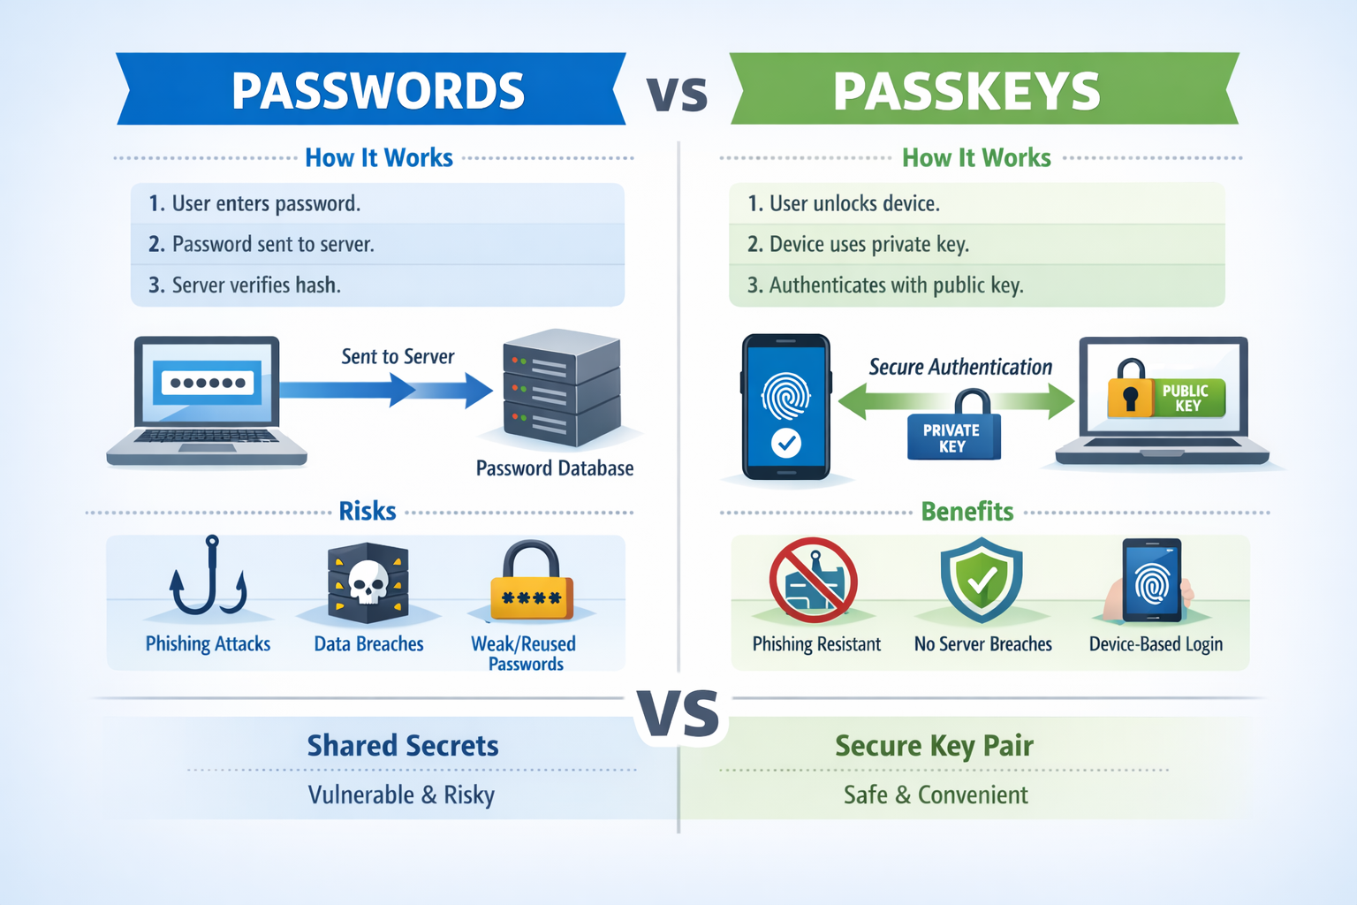

Slide 15
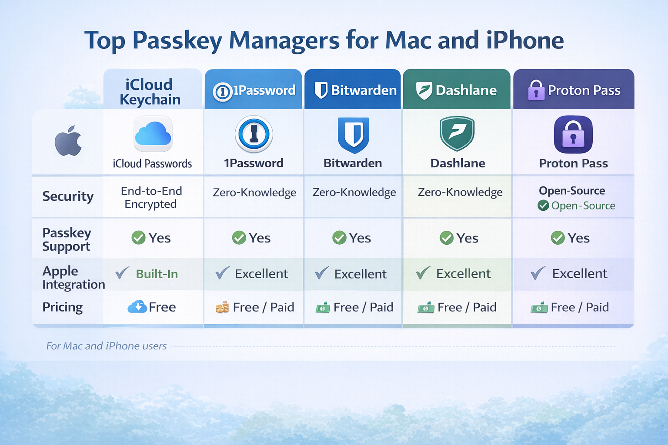

Slide 16
Apple's Authentication Journey
2013
iCloud Keychain — encrypted password sync across Mac devices
2014
Touch ID comes to iPhone — biometric unlock enters the mainstream
2017
Face ID debuts on iPhone X — facial recognition replaces the home button
2019
Sign in with Apple — privacy-focused SSO with Hide My Email
2022
Passkeys announced at WWDC — built on FIDO2/WebAuthn standard
2024
Standalone Passwords app in iOS 18 — finally out of Settings
2025
iOS 26: Passkey portability, auto-upgrades, version history, credit cards

Slide 17
Apple in 2025-26: Leading the Passwordless Push
Passkey Account Creation API
Password Version History
New accounts are created with a passkey from Day One. One tap + Face ID = signed up. No password ever created.
See every previous password for a site with timestamps. A lifesaver if a change doesn't save correctly.
Automatic Passkey Upgrades
Signal APIs
When you sign in with a password, iOS silently creates a passkey in the background. Next time, no password needed.
Apps notify credential managers when usernames change or passkeys are revoked — everything stays in sync.
Passkey Portability
Move passkeys between Apple Passwords, 1Password, Bitwarden, and others. Secure, encrypted, local transfers.
Source: Apple WWDC25 / iOS 26 & macOS Tahoe

Slide 18
Sign in with Apple: Privacy-First Login
Instead of creating a new account with yet another password, tap "Sign in with Apple" to:
vs. Google/Facebook Login
Those services track which apps you use, when, and how often. Apple's version is designed so they can't see your activity.
Authenticate with Face ID / Touch ID — no password to create or remember
"Hide My Email" generates a unique, random email forwarded to your real address
Apple doesn't track your activity across apps or sell your data
Works on non-Apple devices too (web-based Sign in with Apple)
Accounts registered through it appear automatically in Passwords app
NEW: Apple Digital ID
As of 2026, Apple lets you create a digital ID in Apple Wallet using your U.S. passport. Authentication is evolving beyond passwords into identity itself.

Slide 19
Hardware Security Keys: The Physical Option
What is it?
Security Spectrum
A small USB or NFC device (like a YubiKey) that stores your cryptographic credentials in tamper-resistant hardware. You plug it in or tap it against your device to authenticate.
Apple added native FIDO2 security key support in iOS 16.3 (2023), allowing a YubiKey to protect your Apple Account itself.
They're the gold standard for high-security accounts (government, finance, journalism) but overkill for most consumers — which is exactly where passkeys fill the gap.
Password only
Low
Password + SMS code
Medium
Password + Auth app
Good
Passkey (biometric)
Very Good
Hardware key
Highest

Slide 20
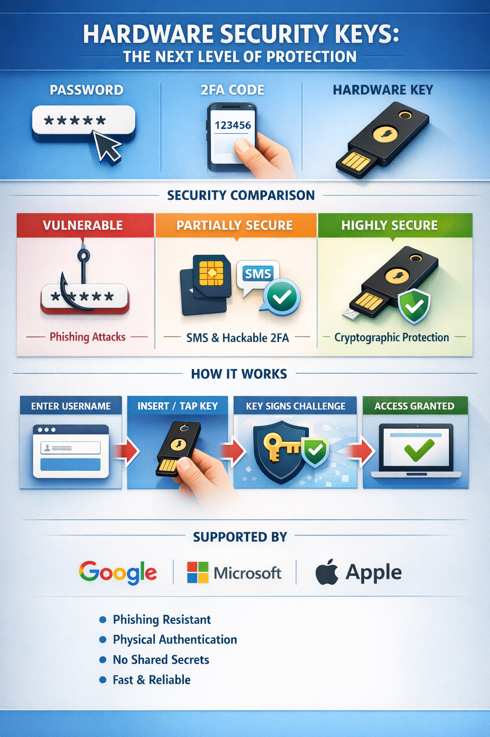

Slide 21
What You Should Do Today
1
Use a Password Manager
Apple's built-in Passwords app is now excellent. 1Password and Bitwarden are great alternatives.
2
Enable 2FA Everywhere
Use an authenticator app (not SMS) for important accounts: email, banking, Apple ID, social media.
3
Switch to Passkeys When Offered
Google, Apple, Microsoft, Amazon, PayPal, and many more now support passkeys. Say yes when prompted.
4
Use Sign in with Apple
When creating new accounts, choose Sign in with Apple to avoid yet another password and protect your email.
5
Keep Your Devices Updated
Authentication security improves with every OS update. iOS 26 and macOS Tahoe bring major passkey upgrades.

Slide 22
The Big Picture: 60 Years in One Slide
1960s
1970s
1990s
2010s
2020s
Passwords Born
Hashing & Crypto
2FA & PKI
Auth Apps & Managers
Passkeys & Passwordless
The trend is clear: authentication is moving from something you KNOW (passwords) to something you ARE (biometrics) and something you HAVE (your device). Passkeys combine both — verified by your face or fingerprint, stored securely on your device.

Slide 23

Questions?
The best password is the one you never have to type.
Apple User Group | 2026

