Slide 1
Using Artificial Intelligence
Mark Griffith

Slide 2


Agenda
Introduction
AI Tools Overview
AI In Action
Prompt Engineering
AI + Human Collaboration
Risks & Limitations
Responsible Use
Getting Started
AI Outlook
Key Takeaways
Q&A

Slide 3

Introduction - What is Artificial Intelligence (AI) and Why Use It?
AI is the use of technology to simulate human intelligence, either in computer programs or robotics
Why Use AI?
Automates repetitive tasks, analyze data, and assist decision-making
Saves time and effort
Improves accuracy
Encourages creativity
Frees us for strategic tasks

Slide 4
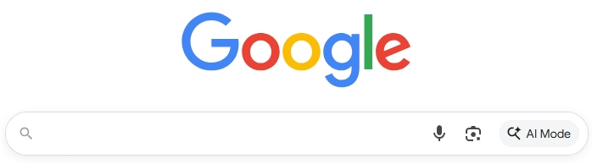




AI Tools Overview
some of the AI tools :
AI Browsers
ChatGPT Atlas – OpenAI
Comet – Perplexity
Norton NEO - Norton
Built-in
Copilot – Microsoft
Gemini – Google
AI Assistants
ChatGPT – OpenAI
Perplexity – Perplexity AI
NotebookLM – Google

Slide 5
AI in Action
Plan meals or vacations
Create budgets
Organize schedules
Write letters and notes
Win the lottery

Slide 6

Prompt Engineering (1 of 2)
Crafting precise prompts is key to quality AI output
Be specific, provide context, define tone and purpose
Insufficient prompt: ‘Write about AI.’
Good prompt: 'Explain in 100 words how AI saves time by automating routine office tasks.’
Small changes in prompts yield big improvements in clarity and accuracy

Slide 7
Prompt Engineering* (2 of 2)
Beware of Hallucinations​
Follow prompting basic guidelines to reduce the risks of getting hallucinations​
Use human judgement, check references for questionable content, read responses​
AI empowers humans and does not replace them. Do not take the human out of the equation​
Not a web search ​
Structure prompts as you would with a human in a conversation​
Tool will remember context of discussion in follow ups​
If you want results in a specific format, ask for it (i.e. tabular)​
Be as descriptive as possible, just like with humans, the more precise the ask, the better the chances of a good outcome​
“Can you tell me how to code against a ForeScout firewall?” Vs “Generate C# code that would integrate with the ForeScout API to add a new firewall rule exception for a specific MAC Address​
* Source: Starr, Michael (2025, October 22). USSF AI Assistant Guardian Training. I3E Integrated Immersive Intelligent Environment

Slide 8


Prompt Refinement Example (1 of 2)
1. Start simple – “Create a hybrid of a Buick Grand National and the Airwolf Helicopter”
2. Add context – “Remove the helicopter and I want the car to look like a future Grand National. Make is aerodynamic like the helicopter but maintain the Grand National look.”

Slide 9


Prompt Refinement Example (2 of 2)
3. Define the goal – “I would like to use the illustration of the car as a potential future Grand National to be used in a flyer to be handed out at a car show.”
4. Request structure or tone – “Place the car on a road showing the car in motion.”

Slide 10

AI + Human Collaboration
AI amplifies human ability; does not replace it
Use AI to complement judgement and creativity

Slide 11

Risks and Limitations
Hallucinations (false info)
Data sensitivity
Over-reliance without verification
Others?

Slide 12

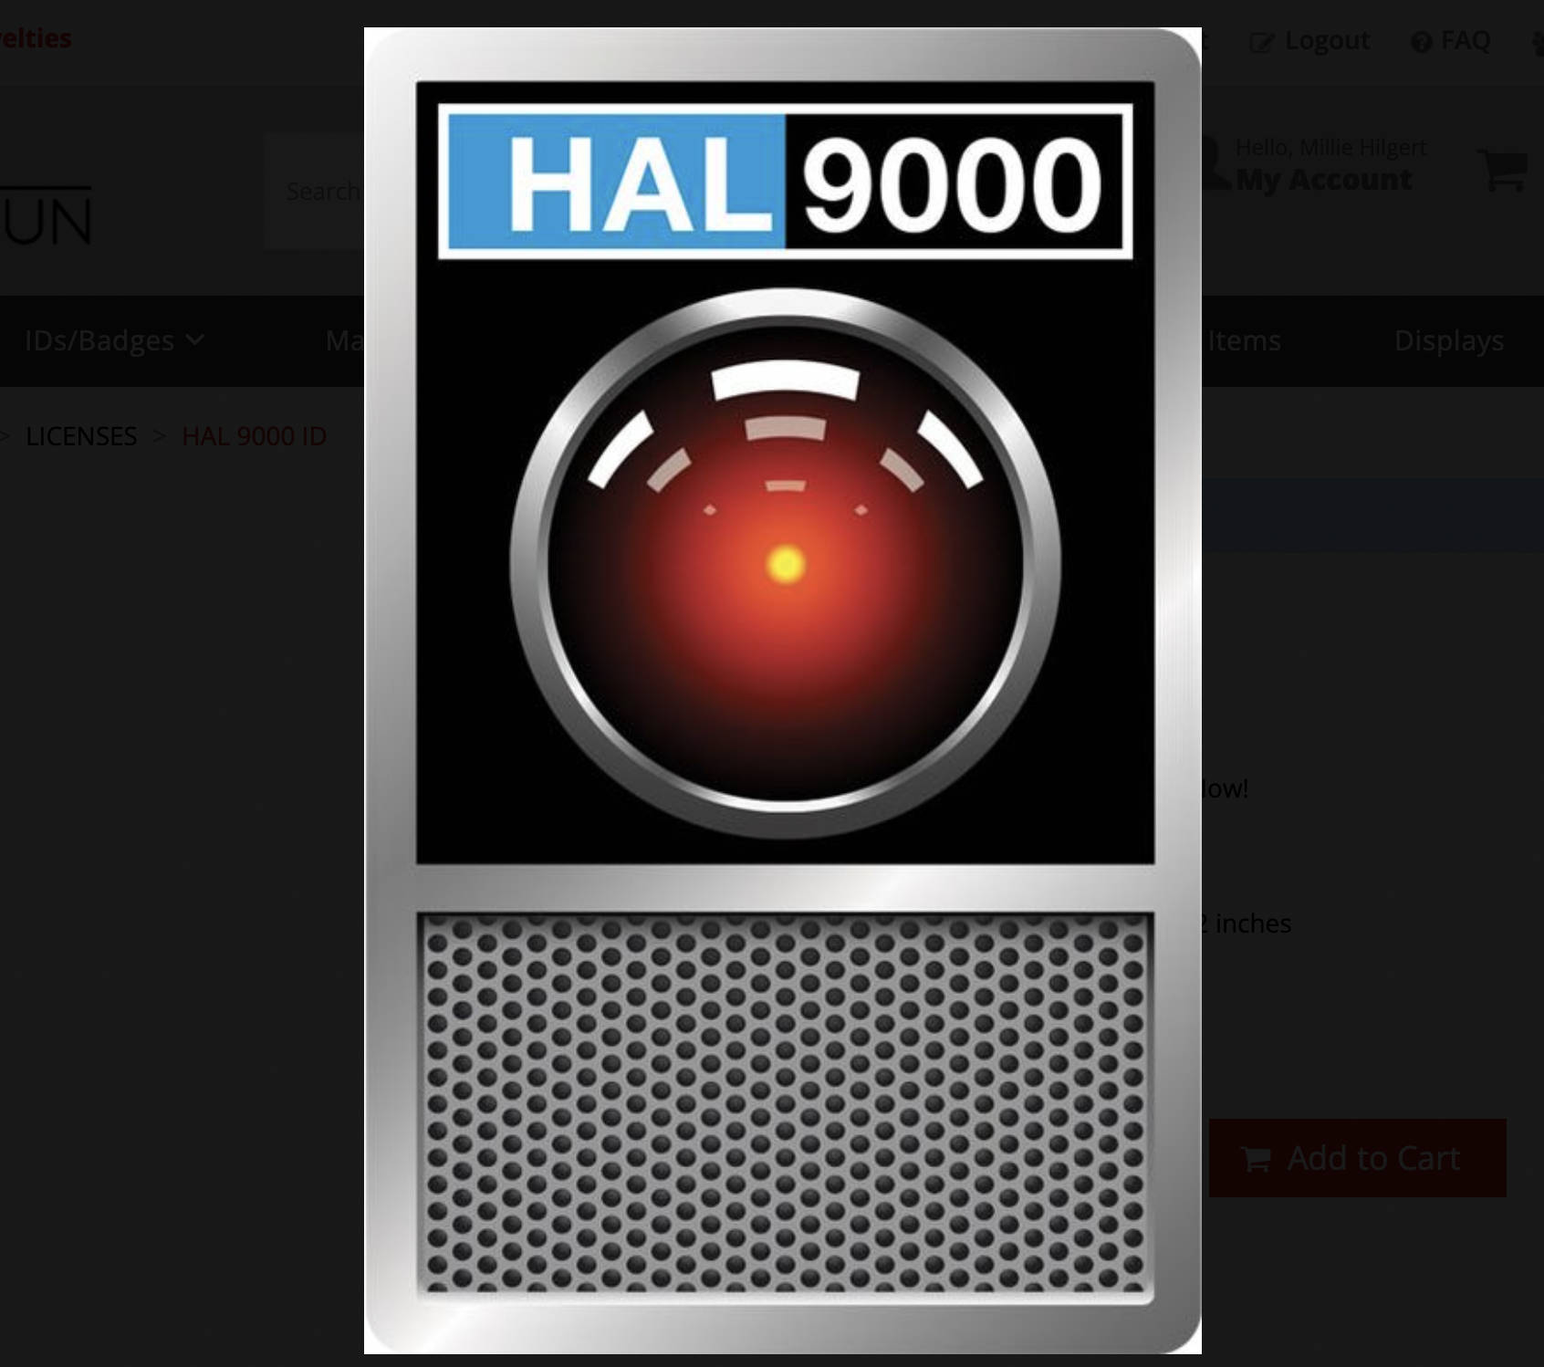
Responsible Use
Verify outputs
Protect sensitive info
Use AI ethically and transparently

Slide 13
Getting Started
Try AI tools
Spend 10 minutes daily experimenting
Share findings with colleagues

Slide 14
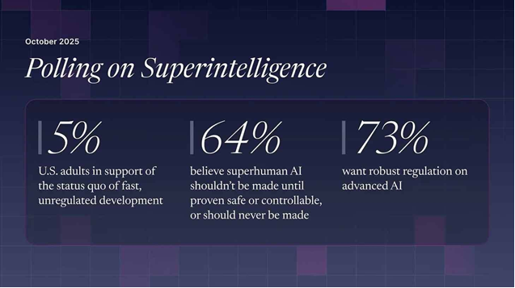

AI Outlook
AI continues to evolve rapidly (e.g. AI integrated browsers)
Staying curious ensures we adapt effectively – have fun!
Where do you fit?
Image source: Future of Life Institute
* Source: Future of Life Institute (2025, October 19). The U.S. Public Wants Regulation (or Prohibition) of Expert‑Level and Superhuman AI. Future of Life Institute. The U.S. Public Wants Regulation (or Prohibition) of Expert‑Level and Superhuman AI - Future of Life Institute
Notes:
A national survey conducted by Bryson Gillette for the Future of Life Institute of 2,000 U.S. adults (29 Sept – 5 Oct 2025) uncovers where Americans stand on AI and the prospect of expert‑level and superhuman systems.
Show The Rundown AI daily e-mail.

Slide 15
Key Takeaways
Start small
Be specific in prompts
Verify results
Use AI responsibly

Slide 16

Questions

Slide 17
Backups

Slide 18
Some Useful AI Terms*
Artificial General Intelligence (AGI) - A concept that suggests a more advanced version of AI than we know today, one that can perform tasks much better than humans while also teaching and advancing its own capabilities.
Agents - a.k.a. Autonomous Agents, are AI models that have the capabilities, programming and other tools to accomplish a specific task. A self-driving car is an autonomous agent is an example.
Generative AI - A content-generating technology that uses AI to create text, video, computer code or images.
Hallucination - An incorrect response from AI. Can include generative AI producing answers that are incorrect but stated with confidence as if correct.
Large Language Model (LLM) - An AI model trained on mass amounts of text data to understand language and generate novel content in human-like language.
Machine Learning (ML) - A component in AI that allows computers to learn and make better predictive outcomes without explicit programming.
Prompt - The suggestion or question you enter into an AI chatbot to get a response.
Prompt Engineering - The process of writing prompts for AIs to achieve a desired outcome. It requires detailed instructions, combining chain-of-thought prompting and other techniques, including highly specific text
Temperature - Parameters set to control how random a language model's output is. A higher temperature means the model takes more risks
Turing Test - Named after famed mathematician and computer scientist Alan Turing, it tests a machine's ability to behave like a human. The machine passes if a human can't distinguish the machine's response from another human.
* Source: Kahn, Imad (2025, October 17). ChatGPT Glossary: 59 AI Terms Everyone Should Know. CNET. ChatGPT Glossary: 59 AI Terms Everyone Should Know - CNET

Slide 19
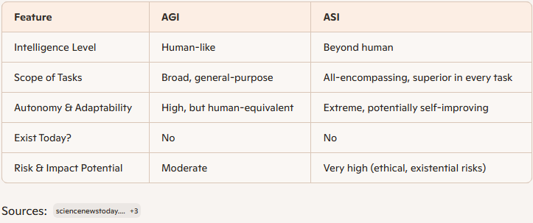
AGI vs ASI
AGI – Artificial Generalized Intelligence
ASI – Artificial Superintelligence

